Slide 1
Upgrade your workflow with a custom package
June 2018
https://github.com/forwards/workshops/
Forwards Teaching Team
https://forwards.github.io

Slide 2
Setup
In order to build and check packages, you will need to install additional tools on your computer, see
https://github.com/forwards/workshops/blob/master/Computing_requirements.md#development-tools
This workshop uses the package development packages devtools, roxygen2, testthat, usethis, plus tidyverse for the example functions.
We’ll also rely on RStudio shortcuts.
You can start setup now or use this RStudio.cloud instance: https://rstudio.cloud/project/38916

Slide 3
Preliminaries

Slide 4
Introductions
Heather Turner
@HeathrTurnr
Forwards
@R_Forwards

Slide 5
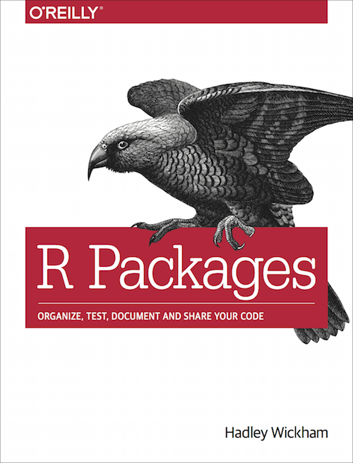
The material is mostly drawn from
http://r-pkgs.had.co.nz
https://amzn.com/1491910399

Slide 6
Your turn
This means that you have to work!
This course is very hands on, and while I’m here to help you, the best resource is often the person sitting next to you.
Introduce yourself to your neighbours. Who are you and what are you using R for?

Slide 7
Why make a package?
You want to test
You want to generalise
You want to document
You want to share

Slide 8
My first package

Slide 9
Your turn
# Create a package on your Desktop:
usethis::create_package("~/Desktop/mypackage")
# Or on RStudio.cloud (create within main project)
usethis::create_package("mypackage")
This will create a new R project and start a new session.
What other files and directories are created?

Slide 10
What happens we run create_package()?
mypackage.Rproj
R/
create_package("mypackage")
DESCRIPTION
NAMESPACE

Slide 11
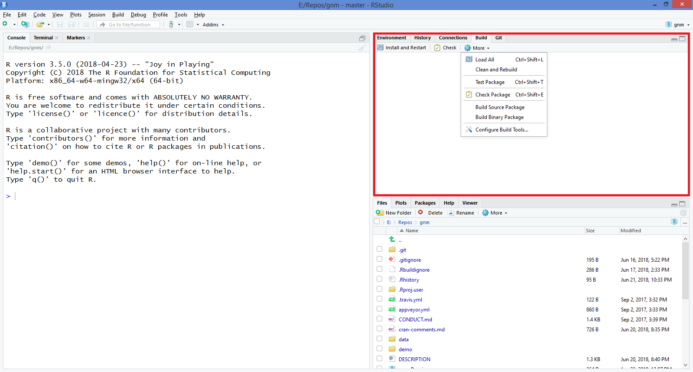
RStudio helpers: build (& git) menus

Slide 12
DESCRIPTION
Package: mypackage
Version: 0.0.0.9000
Title: What the Package Does (One Line, Title Case)
Description: What the package does (one paragraph).
Authors@R: person("First", "Last", , "first.last@example.com", c("aut", "cre"))
License: What license it uses
Encoding: UTF-8
LazyData: true
ByteCompile: true

Slide 13
Development workflow

Slide 14
How is developing a package
same / different
from developing a script?

Slide 15
How same?
Iterate early and often!
Change it, try it, change it, try it, ad nauseum

Slide 16
How different?
Write functions, not “top-level” code.
Dependencies are different,
no library() calls.
Install & Restart (or simulate that),
don’t source().

Slide 17
You write this
… but you use this
Figure from Hadley Wickham’s book, R packages
http://r-pkgs.had.co.nz
https://github.com/hadley/r-pkgs/blob/master/diagrams/installation.png

Slide 18
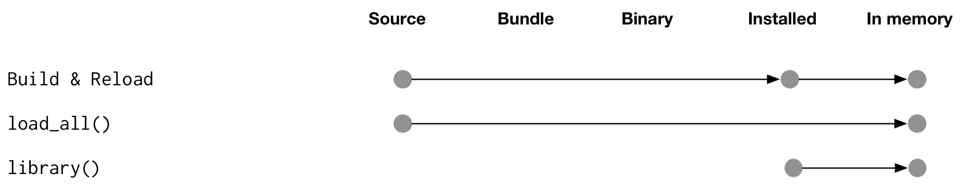
How do packages get into memory?
Development: every couple hours or days?
Development: Every 2 minutes
Install and Restart
Normal day-to-day usage
Figure from Hadley Wickham’s book, R packages
http://r-pkgs.had.co.nz
https://github.com/hadley/r-pkgs/blob/master/diagrams/loading.png

Slide 19
Basic workflow
You don’t even need to save your code!
Modify code
devtools::load_all()
Cmd/Ctrl + Shift +L
Explore in console

Slide 20
Your turn
[Uses https://github.com/forwards/mylittlepony]
Open mylittlepony.Rproj.
Load all the functions, then run rpony(10).
Uhoh! I have forgotten to include Fluttershy in the list of ponies. Add her, reload the code, and verify that your change worked.

Slide 21
Testing workflow

Slide 22
Example: add columns to a data frame
add_cols <- function(x, y, where = 1) {
if (where == 1) {
cbind(y, x)
} else if (where > ncol(x)) {
cbind(x, y)
} else {
lhs <- 1:(where - 1)
cbind(x[lhs], y, x[-lhs])
}
}

Slide 23
Common workflow
# Create some simple inputs
df1 <- data.frame(a = 3, b = 4, c = 5)
df2 <- data.frame(X = 1, Y = 2)
# Tweak function in development, then re-run
# test cases
add_cols(df1, df2, where = 1)
add_cols(df1, df2, where = 2)
add_cols(df1, df2, where = 3)
add_cols(df1, df2, where = 4)

Slide 24
Two challenges
Duplication/unsaved changes
Looking at the outputs of each run is tedious

Slide 25
We need a better workflow!
Duplication/unsaved changes
Create a formal suite of unit tests
Looking at the outputs of each run is tedious
Use devtools::test() to run & check

Slide 26
Testing workflow
Write R code
Reload code
Cmd/Ctrl + Shift + L
devtools::load_all()
Run automated tests
Cmd/Ctrl + Shift + T
devtools::test()

Slide 27
Adding tests using testthat
usethis::use_test()
✔ Adding 'testthat' to Suggests field
✔ Creating 'tests/testthat/'
✔ Writing 'tests/testthat.R'
✔ Writing 'tests/testthat/test-add_cols.R'
● Modify 'tests/testthat/test-add_cols.R'
Set up testthat inafrastructure
Create test file matching script

Slide 28
Key idea of unit testing is to automate!
at_pos <- function(i) {
add_cols(df1, df2, where = i)
}
expect_named(at_pos(1), c("X", "Y", "a", "b", "c"))
expect_named(at_pos(2), c("a", "X", "Y", "b", "c"))
expect_named(at_pos(3), c("a", "b", "X", "Y", "c"))
expect_named(at_pos(4), c("a", "b", "c", "X", "Y"))
Helper function to reduce duplication
Describes an expected property of the output

Slide 29
And this automation must follow conventions
Tests for R/add_cols.R
# In tests/testthat/test-add_cols.R
context("add_cols")
test_that("can add column at any position", {
at_pos <- function(i) {
add_cols(df1, df2, where = i)
}
expect_named(at_pos(1), c("X", "Y", "a", "b", "c"))
expect_named(at_pos(2), c("a", "X", "Y", "b", "c"))
expect_named(at_pos(3), c("a", "b", "X", "Y", "c"))
expect_named(at_pos(4), c("a", "b", "c", "X", "Y"))
})

Slide 30
Tests are organised in three layers
File
One per .R file in R/
Hard to define precisely. One per “chunk” of functionality.
Test
Test
Expectation
Expectation
Test
Expectation
Expectation
Expectation
Expectation
Expectation
Expectation
Expectation
Expectation
Expectation
Very fine grained
Test
Expectation
Expectation
Expectation

Slide 31
Four expectations cover 90% of cases
# check good inputs give correct output
expect_equal(object, expected)
expect_known_output(code)
# check bad inputs are caught (early, with useful message!)
expect_error(code, regexp)
expect_warning(code, regexp) expect_warning(code, NA)

Slide 32
Practice the workflow
[Uses mini-course branch of https://github.com/forwards/hadcol]
Open hadcol.Rproj.
Verify the current tests pass with Cmd + Shift +T.
Add a new test to test that invalid `where` gives a helpful error message:
Write an expectation and confirm the test fails
Update `add_cols` to make the test pas

Slide 33
Function documentation with roxygen2

Slide 34
You write specially formatted comments in .R
#' Add a column to a data frame
#'
#' Allows you to specify the position. Will replace existing variable
#' with the same name if present.
#'
#' @param x A data frame
#' @param name Name of variable to create. If a variable of that name
#' already exists it will be replaced
#' @param value Values to insert.
#' @param where Position to insert. Use 1 to insert on LHS, or -1 to insert on
#' RHS.
#' @examples
#' df <- data.frame(x = 1:5)
#' add_col(df, "y", runif(5))
#' add_col(df, "y", runif(5), where = 1)
#'
#' add_col(df, "x", 5:1)

Slide 35
You write specially formatted comments in .R
#' Add a column to a data frame
#'
#' Allows you to specify the position. Will replace existing variable
#' with the same name if present.
#'
#' @param x A data frame
#' @param name Name of variable to create. If a variable of that name
#' already exists it will be replaced
#' @param value Values to insert.
#' @param where Position to insert. Use 1 to insert on LHS, or -1 to insert on
#' RHS.
#' @examples
#' df <- data.frame(x = 1:5)
#' add_col(df, "y", runif(5))
#' add_col(df, "y", runif(5), where = 1)
#'
#' add_col(df, "x", 5:1)
roxygen comment
roxygen tag

Slide 36
roxygen2 translates to .Rd
In almost all cases you can ignore these files
% Generated by roxygen2: do not edit by hand
% Please edit documentation in R/add_col.R
\name{add_col}
\alias{add_col}
\title{Add a column to a data frame}
\usage{
add_col(x, name, value, where = -1)
}
\arguments{
\item{x}{A data frame}
\item{name}{Name of variable to create. If a variable of that name
already exists it will be replaced}
\item{value}{Values to insert.}
\item{where}{Position to insert. Use 1 to insert on LHS, or -1 to insert on
RHS.}
}
\description{
Allows you to specify the position. Will replace existing variable
with the same name if present.
}

Slide 37
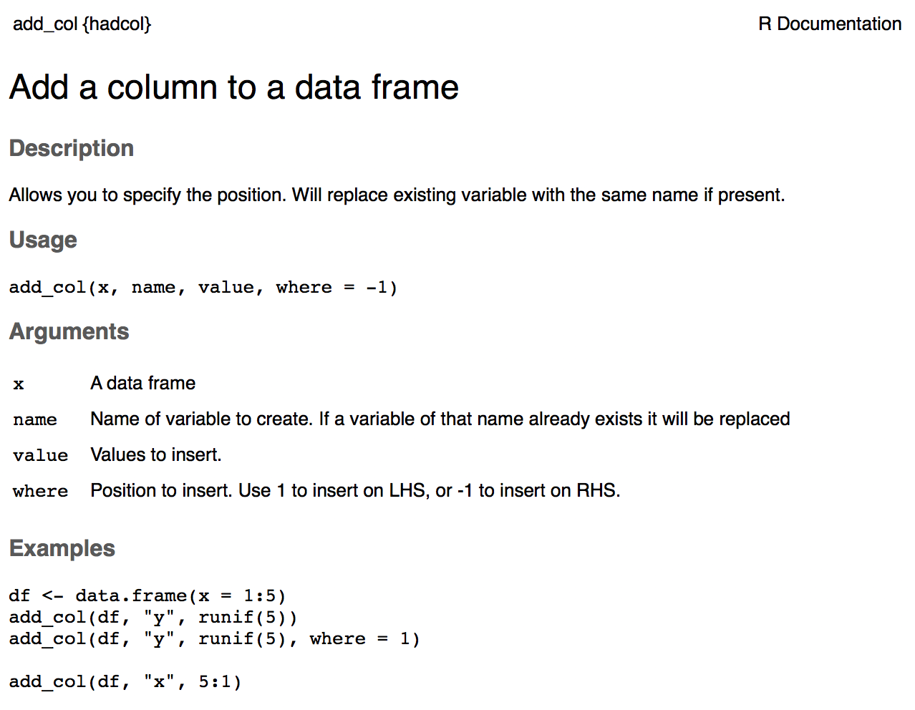
R translates to .html for viewing

Slide 38
The description block
#' Sum of vector elements
#'
#' \code{sum} returns the sum of all the values present in its arguments.
#'
#' This is a generic function: methods can be defined for it directly or via the
#' \code{\link{Summary}} group generic. For this to work properly, the arguments
#' \code{...} should be unnamed, and dispatch is on the first argument.
First sentence is the title
Next paragraph is the description
Further paragraphs go in Details

Slide 39
Use markdown for formatting
# Activate by running
usethis::use_roxygen_md()
**bold**, _italic_, `code`
* [func()]
* [pkg::func()]
* [link text][func()]
* [link text][pkg::func()]

Slide 40
There are five tags you’ll use for most functions
Tag | Purpose
@param arg | Describe inputs
@examples | Show how the function works. (Usual RStudio shortcuts work)
@seealso | Pointers to related functions
@return | Describe outputs (value)
@export | Is this a user-visible function?

Slide 41
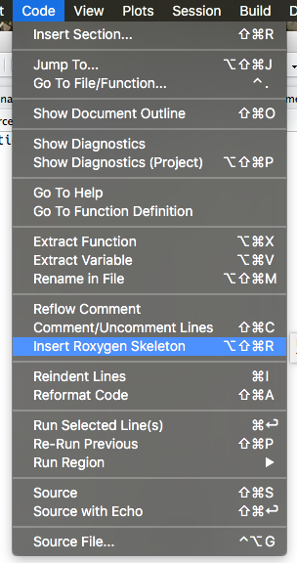
RStudio helps you remember
#' Title
#'
#' @param x
#' @param y
#' @param z
#'
#' @return
#' @export
#'
#' @examples
fun <- function(x, y, z) {
}

Slide 42
Documentation workflow
Modify R comment
Update Rd files
Cmd/Ctrl + Shift + D
devtools::document()
Preview
?topicname

Slide 43
Documentation workflow
Modify R comment
Update Rd files
Cmd/Ctrl + Shift + D
devtools::document()
NB: You must have loaded the package with load_all() at least once
Preview
?topicname
Only shows single file, so links do not work

Slide 44

Documentation workflow 2
Modify R comment
Update Rd files
Cmd/Ctrl + Shift + D
devtools::document()
Install package & restart R
Cmd/Ctrl + Shift + B
This is slower than the previous workflow, but there are fewer caveats
Preview
?topicname

Slide 45
Your turn
Document add_cols().
(Use “Insert Roxygen Skeleton” to get you started!)

Slide 46
Package documentation

Slide 47
Vignettes
Long-form documentation, e.g. theory, case studies, etc
usethis::use_vignette("name")
# Adds to DESCRIPTION
Suggests: knitr
VignetteBuilder: knitr
# Creates vignettes/
# Drafts vignettes/name.Rmd

Slide 48
Vignette = Rmarkdown + special metadata
---
title: "Vignette Title"
author: "Vignette author"
date: "`r Sys.Date()`"
output: rmarkdown::html_vignette
vignette: >
%\VignetteIndexEntry{Vignette Title}
%\VignetteEngine{knitr::rmarkdown}
%\VignetteEncoding{UTF-8}
---
Special output format for vignettes
Special metadata needed by R

Slide 49
Vignette workflow
Build entire package & Restart R
Modify R code
Cmd/Ctrl + Shift + B
Modify Rmarkdown file
Preview file
Cmd/Ctrl + Shift + K
Preview whole package
devtools::install(build_vignettes = TRUE)
browseVignettes()

Slide 50
Other documentation
README: quick start guide (public) , notes (private)
usethis::use_readme_md()
usethis::use_readme_rmd() # show output
NEWS: record of changes (between versions)
usethis::use_news_md()
pkgdown website: generates website using README, Rd, vignettes and NEWS
pkgdown::build_site()

Slide 51
Dependencies

Slide 52
Imported package
A required package that will be installed automatically
usethis::use_package ("foo“)
# In DESCRIPTION
Imports: foo
# In bar.R
new_function <- function(x, y, z) {
foo::bar(x, y) + z
}

Slide 53
Suggested package
An optional package: only used in development/vignette/example.
usethis::use_package("foo", "suggests")
# In DESCRIPTION
Suggests: foo
# In bar.R
new_function <- function(x, y, z) {
if (!requireNamespace("foo", quietly = TRUE)) {
stop("Need foo! Use install.packages('foo').")
}
foo::bar(x, y) + z
}

Slide 54
You might get tired of using :: all the time
# Or you might want to use an infix function
`%>%` <- magittr::`%>%`
col_summary <- function(df, fun) {
stopifnot(is.data.frame(df))
df %>%
purrr::keep(is.numeric) %>%
purrr::modify(fun)
}

Slide 55
You can import the required functions
#' @importFrom purrr keep modify
#' @importFrom magrittr %>%
col_summary <- function(df, fun) {
stopifnot(is.data.frame(df))
df %>%
keep(is.numeric) %>%
modify(fun)
}

Slide 56
NAMESPACE
Specifies any imported and exported functions – generated automatically by roxygen2.
The default NAMESPACE exports everything
exportPattern("^[^\\.]")
Better to export explicitly
#' @export
fun1 <- function(...) {}

Slide 57
A namespace splits functions into two classes
Internal | External
Only for use within package | For use by others
Documentation optional | Must be documented
Easily changed | Changing will break other people’s code

Slide 58
R CMD check

Slide 59
Checking for common problems
# Cmd/Ctrl + Shift + E
devtools::check()
To avoid frustration, run early and run often!

Slide 60
Example check output (truncated)
Updating mypackage documentation
...
Building mypackage ---------------------------------------------------
...
Checking mypackage ---------------------------------------------------
...
* this is package 'mypackage' version '0.0.0.9000
...
* checking package namespace information ... OK
...
* checking DESCRIPTION meta-information ... WARNING
Non-standard license specification:
What license it uses
Standardizable: FALSE
...
* checking examples ... NONE
...
* DONE

Slide 61
Example check summary (end of output)
R CMD check results
checking DESCRIPTION meta-information ... WARNING
Non-standard license specification:
What license it uses
Standardizable: FALSE
checking for missing documentation entries ... WARNING
Undocumented code objects:
'tmp'
All user-level objects in a package should have documentation entries. See chapter 'Writing R documentation files' in the 'Writing R Extensions' manual.
0 errors | 2 warnings | 0 notes

Slide 62
Your turn
Modify add_cols to use dplyr::bind_cols.
Run the package check to confirm that there are no issues.

Slide 63
Learning more

Slide 64
Further topics
Including data
Licenses
CRAN submission
Good practice
Version control (git and GitHub)
Code coverage (code covered by unit tests)
Continuous integration (automated checking)
Advanced programming
Interfacing with C++
Object-oriented programming
…

Slide 65
Resources
Online books/manuals
R packages http://r-pkgs.had.co.nz
Advanced R http://adv-r.hadley.nz/
Happy Git and GitHub for the useR http://happygitwithr.com/
R-exts https://cran.r-project.org/doc/manuals/r-release/R-exts.html
Forums/mailing lists
community.rstudio.com
R-package-devel mailing list

Slide 66
This work is licensed under the Creative Commons Attribution-Noncommercial 3.0 United States License.
To view a copy of this license, visit http://creativecommons.org/licenses/by-nc/3.0/us/

